Slide 1
Project Sponsor
This project is funded by the USDA National Institute of Food and Agriculture. Project number 2009-01929.

Slide 2
Project Participants

Slide 3
Project Management Highlights
Monthly conference calls
Participants
Steering committee
Advisory committee members
Any project participant
Goal
Up-date everyone on recent project activity
Plan upcoming activities
Minutes provided on-line
Advisory Board resignation
Dr. Chuck Hibberd, Purdue Extension resigned
Dr. Christine Bruhn agreed to serve on board
Dr. Fred Bliss, resigned
Dr. Steve Beebe agreed to serve on board

Slide 4
Objective 1: Market-class specific markers
Market class | n | % polymorphic SNPs
Snap Bean | 134 | 59.6
Pinto | 91 | 50.3
Small red | 29 | 48.7
Pink | 17 | 45.5
Great Northern | 48 | 41.5
Small White | 6 | 39.2
Navy | 43 | 36.4
Black | 42 | 33.0
Light red kidney | 32 | 30.3
Dark red kidney | 15 | 23.8
White kidney | 8 | 17.6
Cranberry | 19 | 14.3

Slide 5
Objective 1: Market-class specific markers
Linkage group | SNPs mapped in 2011 | SNPs mapped previously | Total SNPs | LG length (cM)
Pv01 | 760 | 73 | 833 | 143.7
Pv02 | 518 | 48 | 566 | 197.0
Pv03 | 531 | 55 | 586 | 175.9
Pv04 | 708 | 47 | 755 | 154.8
Pv05 | 666 | 29 | 695 | 135.1
Pv06 | 199 | 28 | 227 | 103.8
Pv07 | 192 | 30 | 222 | 141.1
Pv08 | 824 | 38 | 862 | 196.8
Pv09 | 449 | 41 | 490 | 159.7
Pv10 | 763 | 42 | 805 | 135.4
Pv11 | 923 | 54 | 977 | 122.3
Total | 6553 | 485 | 7018 | 1665.5

Slide 6
Objective 1: Market-class specific markers
Market Class | Indels (>7 nt) preprocessing | Indels (>7 nt) postprocessing
Pinto | 9,634 | 1,358
Navy | 1,515 | 339
Black | 1,954 | 299
Light red kidney | 5,524 | 649
Dark red kidney | 1,378 | 66
Total | 20,005 | 2,711
Current catalog of common bean markers
10,453 SNP markers
2,711 indel markers
13,164 new markers for common bean

Slide 7
Objective 1: Market-class specific markers
Pinto indel markers useful in other market classes
PBN-3187434
Great
Northern
Black
Navy
Small red
Pink
Pinto
PBN-411737
Great
Northern
Black
Navy
Small red
Pink
Pinto

Slide 8
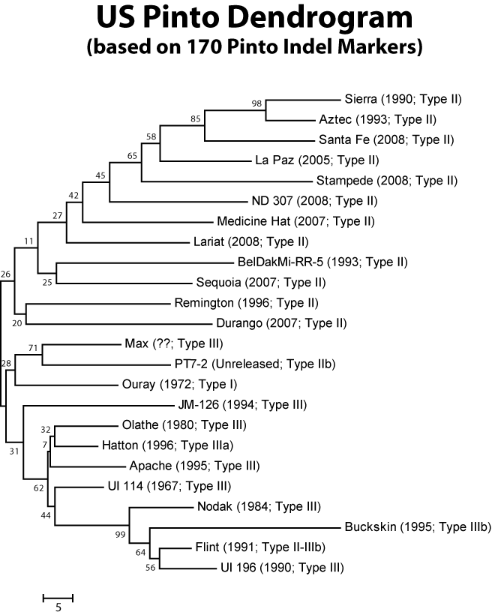
Objective 1: Market-class specific markers
Newer, upright pintos
F_{st} = 0.25
Older, prostrate pintos
Pinto indel markers useful in other market classes
Indel PBN-3187434
Great
Northern
Black
Navy
Small red
Pink
Pinto
Indel PBN-411737
Great
Northern
Black
Navy
Small red
Pink
Pinto

Slide 9
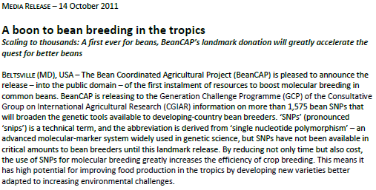
Objective 1: Market-class specific markers

Slide 10
Objective 2: Nutritional Phenotyping
Elements | BeanCAP range | Fold range
Macro (mg/g DW)
Ca | 0.40 – 3.75 | 9.5 x
K | 10.50 – 15.78 | 1.5 x
Mg | 1.21 – 2.40 | 2.0 x
P | 3.25 – 6.52 | 2.0 x
S | 1.50 – 2.60 | 1.7 x
Micro (µg/g DW)
Cu | 6.59 – 13.86 | 2.1 x
Fe | 47.16 – 101.39 | 2.1 x
Mn | 10.05 – 19.98 | 2.0 x
Na | not detected
Ni | 0.62 – 6.28 | 10.2 x
Se | 0.28 – 1.01 | 3.6 x
Zn | 31.03 – 68.54 | 2.2 x

Slide 11
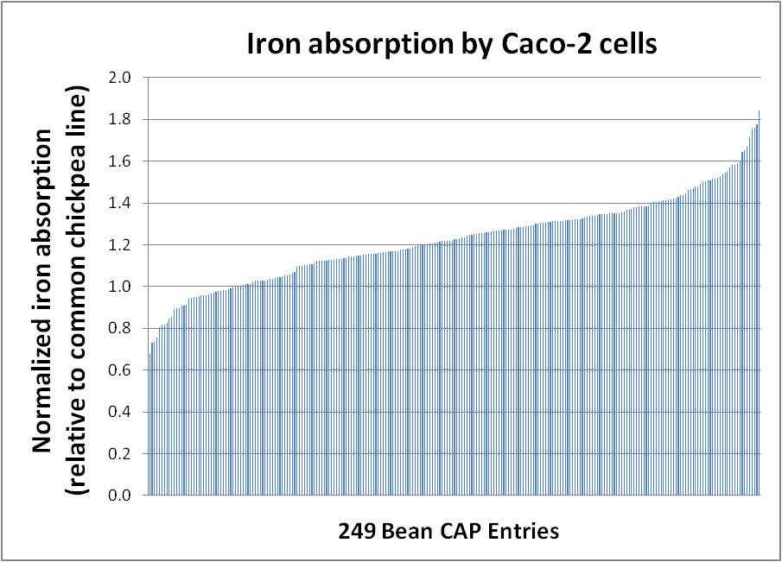
Objective 2: Nutritional Phenotyping

Slide 12
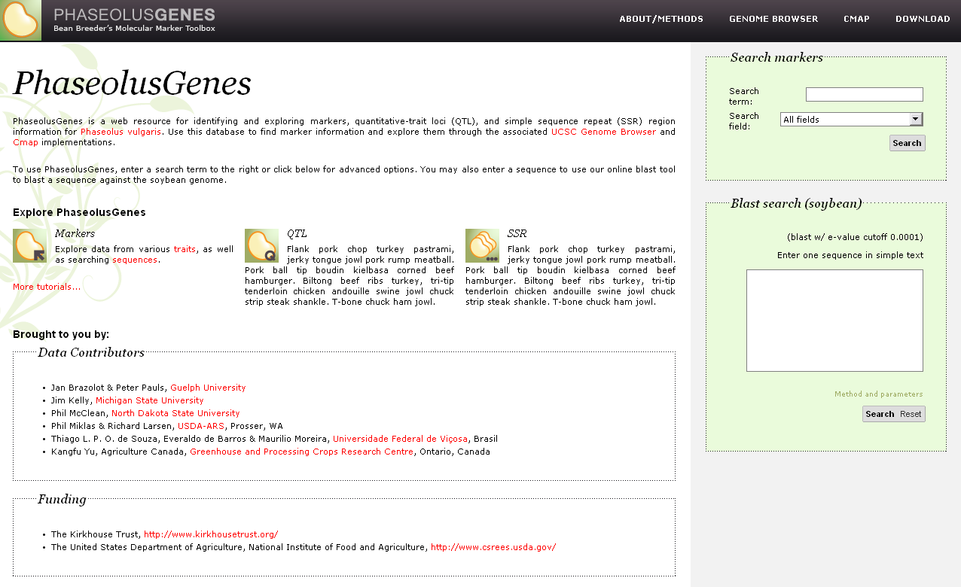
Objective 3: PhaseolusGenes Database

Slide 13
Objective 3: PhaseolusGenes Database
MAPPED MARKERS
Type/Source | Name | Total | Mapped
STS
Hougaard et al. 2008 | Leg | 195 | 105
Various |  | 12 | 11
Murray et al. 2002 | Bng | 130 | 89
Kami et al. , unpubl. | D | 113 | 9
Kim et al. 2006 | COS | 120 | 0
McConnell et al. 2010 | g | 302 | 295
David et al. 2008 | B4 BACs | 114 | 114
Total STS |  | 986 | 623
Genes |  | 25 | 15
SCARS |  | 78 | 69
SSRs
Blair et al. , various | BM | 692 | 210
Yu et al. 2000 | Pv | 37 | 19
Buso et al. 2006, Grisi et al. 2007 | PVBR | 81 | 55
Hanai et al. 2010 | PVM | 140 | 45
Hanai et al. 2007 | FJ | 40 | 0
Benchimol et al. 2007, Oblessuc et al. 2009 | IAC, IAC-SSR | 173 | 0
Cardoso et al. 2008 | SSR-IAC | 99 | 0
Total SSR |  | 1,262 | 329
Total |  | 2,351 | 1,036

Slide 14
Objective 3: PhaseolusGenes Database
Name | Parents | Pop | Type | Source | Type of markers | # markers
Bean01 | BJ | RI | MA | Freyre et al. 1998 | Phenotypic, RFLP, RAPD, AFLP; SCAR;Allozyme | 234
Bean02 | BJ | RI | MA | McClean 2007; McConnell et al. 2010 | STS: g, CAPS, dCAPS, indel; SCAR; RAPD, AFLP | 450
Bean03 | BJ | RI | MA | Navarro Gomes & Gepts 2011 | STS: g, Leg, Bng, D, RFLP; | 485
Bean04 | BJ | RI | MA | Galeano et al. 2011 | STS: Leg; SNP: g | 424
Bean05 | DOR364 x BAT477 | RI | MM | Galeano et al. 2011 | SSR, SSR-BES, RAPD, AFLP | 291
Bean06 | DOR364 x G19833 | RI | MA | Galeano et al. 2011 | SSR, SNP, STS: RFLP, Leg | 499
Bean07 | Consensus | NA | NA | Galeano et al. 2011 | SSR; SNP; STS: Leg, g, Bng | 1,010

Slide 15
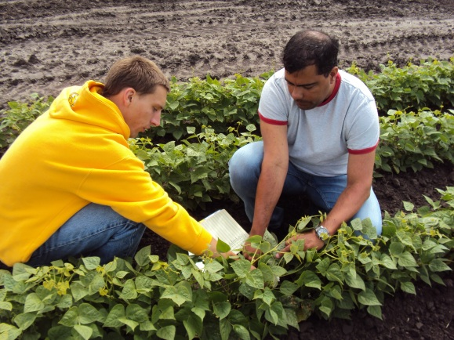
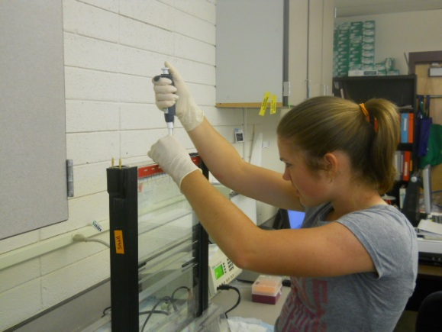
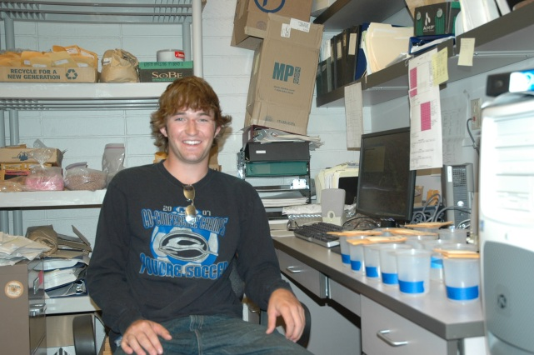
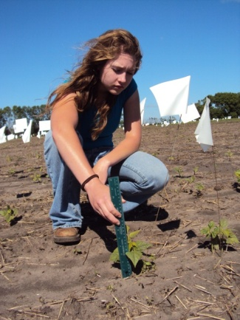
Objective 4: Early Breeder Training
Two graduates of program are in graduate plant breeding programs
19 student interns for 2010
~170 high school students visited during 2010

Slide 16
Objective 5: Multimedia Development
2011 Outcomes
Spillin’ the Beans (Julie Garden-Robinson)
Bean nutrition curriculum
Mineral transport animation (Christina Johnson)
Recruiting documentary, Part 2 (Bree Reetz, Shane Reetz)
How to make a difference: Norman Borlaug Story
Root biology documentary (Shane Reetz)
Shovelomics How-to (Shane Reetz)
New techniques for screening root traits
2012 Plans
Genetic Diversity Documentary (Part 3)
How plant breeding solves problems: US wheat stem rust story
Young Plant Breeders Documentary (Part 4)
Why students are interested in plant breeding
Minerals and human nutrition animation(s)

Slide 17
85 Active Participants
North Dakota State Univ: Phillip McClean, PD; Juan Osorno, Co-PD, education lead, breeding; Julie Garden-Robinson, Co-PD, extension; Michelle Grant, Administrative assistant; Bradley Bisek, intern; Nicole Dallman, intern; Kataryna Cookman, intern; Mitchell Bauske, intern; Lyndsie Park, intern; Peter Totten, intern; Christina Johnson, Artistic lead; Shane Reetz, Documentary lead; Bree Malingnen, Infrographics artist; Samira Mafi Moghaddam, Marker development; Rian Lee, Marker development; Sujan Mamidi, Statistical analysis; Stacy Halvorson, extension associate; Leah Whigham, nutrition researcher; Deb Habedank, childcare director; Todd Weinmann, extension agent; Steve Sagaser, extension agent; Chelsea Langus, intern; Alexandra Idso, intern; Aimee Henning, intern, Kendra Otto, intern; Emily Westrom, intern; Amy Hutchinson, intern; Kayla Bahtiraj, intern. Univ Nebraska, Lincoln: Carlos Urrea, , Co-PD; Nicole Schnitger, intern; Misty Griffitts, intern; Scout Wilson, intern; Charity Berkey, intern; Danielle Becker, intern; USDA/Houston: Michael Grusak, Co-PD, nutritional analysis; Paz Etcheverry, cooperator; David Dworak, technician; Lori Center, technician; William Carter, intern; Oregon State Univ: Jim Myers,; Co-PD, Nutritional analysis, breeding; Annie Chozinski, faculty research assistant; Kara Young, intern; Katrina Maguelli, intern. Univ California, Davis: Paul Gepts, Co-PD, data base development; Shelby Repinski, Graduate student, QTL entry to database; Adriana Navarro Gomez, Graduate student, QTL entry to database; Sun Lei, Graduate student; Tania Gioia, Graduate Student; Dawei Lin, Bioinformatics and database lead; Jose Boveda, Database/web programmer; Joe Fass, Lead programmer; Nikhil Joshi, Bioinformatics programmer; Monica Britton, Bioinformatics analyst; Zhi-Wei Lu, Bioinformatics analyst. Michigan State Univ: Jim Kelly, Co-PD, Breeding, education; Evan Wright, technician; Amy Lasley, MSU, graduate student; Valerio Hoyos Villegas, graduate student; Rosa Castanon, intern; Brittany Lane, intern. USDA/Prosser: Phil Miklas, Co-PD, Field increase of core population; Susan Swanson, technician; Jennifer Trapp, technician; Jeff Coulson, technician. USDA/Beltsville: Perry Cregan, Co-PD, Marker development and screening; David Hyten, Marker development and screening; Edward Fickus, Marker development technician; Qijiain Song, Bioinformatics analysis; Gaofeng Jia, marker and bioinformatics analysis; Josaine Rodriques, Federal University of Vicosa, Brazil, SSR analysis, graduate; Charles Quigley, research DNA sequencing. Seminis: Ken Kmecik, Greenhouse/field increase of core population. Colorado State Univ: Mark Brick, Breeding, education, nutrition analysis; Henry Thompson, Nutrition analysis; Soni Hueftle, intern; Griffin Carpenter, intern; Keera Brown, intern; Alyssa Bollig, intern; Dimas Echeveria Moreno, Research associate, nutrition analysis. USDA/East Lansing: Karen Cichy, Co-PD, Nutritional analysis; Nicole Butler, graduate student; USDA/Mayquez, PR: Tim Porch, Co-PD, Field stress analysis; Abraham Montes, technician; Franquie Colon, research assistant; Gregory Howard, research; Edlin Gonzalez, research.

